Slide 1

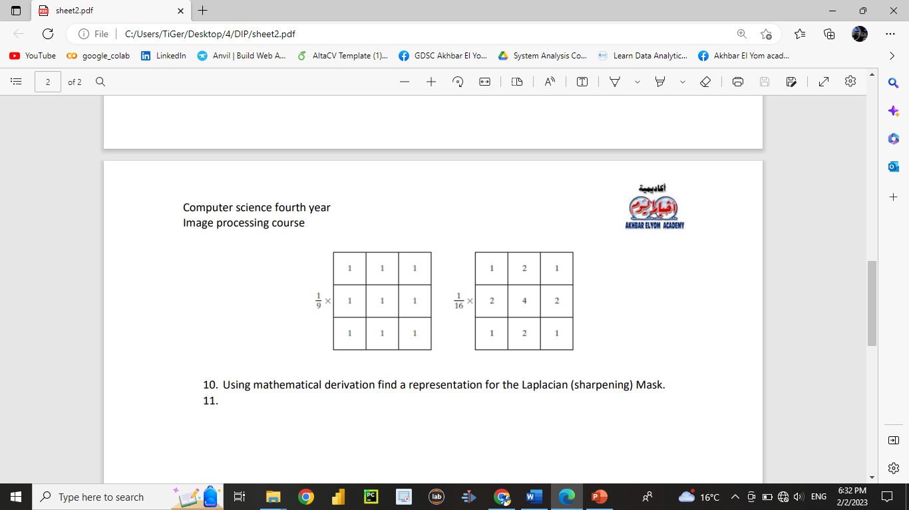
Digital Image Processing
23-What is the effect of using these mask matrices on a gray scale image.
And what is the difference between the first matrix and second matrix.
We use them for blurring and Noise reduction
and if we increase the number of iterations, the image will be more blurred
First matrix 1/9 > Standard average filter (Box filter)
Second matrix 1/16 > Weighted average filter.

